Slide 1

Data Analytics Project
IMMIGRATION
ANALYSIS
IN CANADA
Grha Gandana P

Slide 2

Analysis Objective
Canada has great reputation for being a friendly and safe place to live and raise a family. Generally speaking, moving to Canada is not too difficult. Because Canada is open to welcoming new immigrants and offers several immigration programs. With numerous number of people around the world who have immigrated to Canada, surely it affected the society, economy, and several aspects in Canada. By knowing the trend of immigration in Canada, hopefully there will be policies that regulates the society of Canada that bring prosperity.

Slide 3
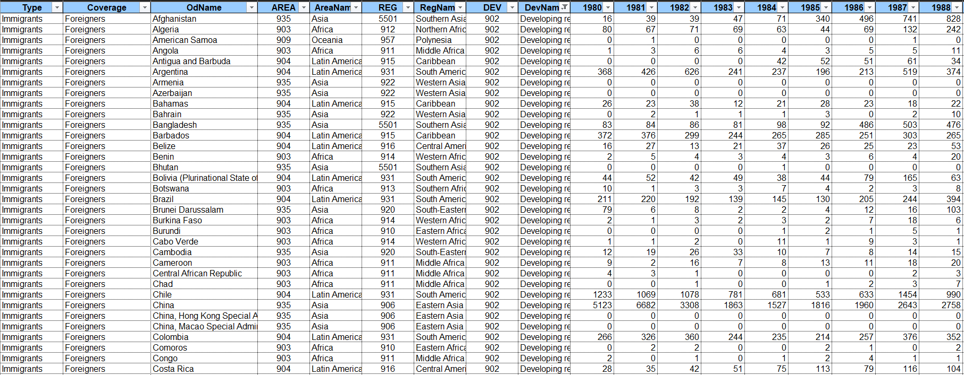
Data Gathering
Dataset consist of several columns: Type, Coverage, OdName, AREA, AreaName, REG, RegName, DEV, DevName and Number of immigrants per each year (1980 - 2013)

Slide 4
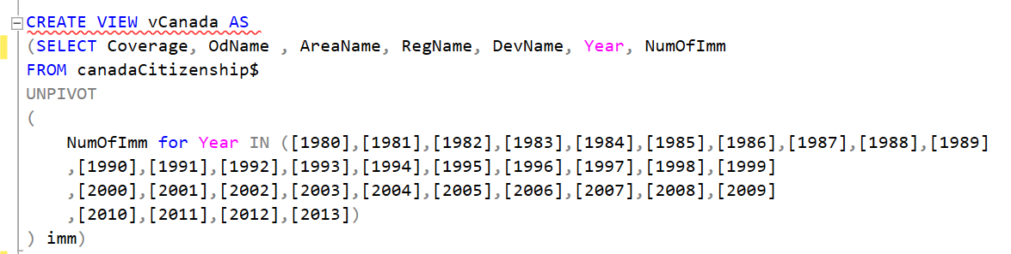
Data Transformation
Unpivoting 1980 – 2013 Columns
Selecting Important Columns
Columns | Description
Coverage | Status of citizenship whether citizen or foreigner
OdName | Countries name
AreaName | Continents name
RegName | Region of continents name
DevName | Status of countries whether developed or developing countries
Year | Year
NumOfImm | Number of citizen/foreigner

Slide 5




Exploratory Data Analytics
Build Visualization and Dashboard
Statistics Descriptive
Univariate Analysis
Gathering Insights

Slide 6
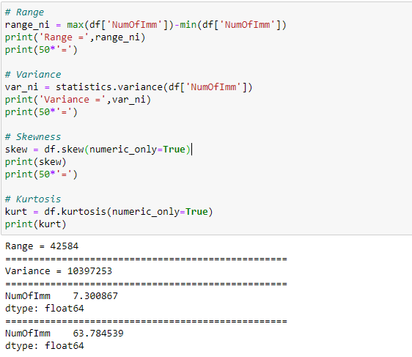
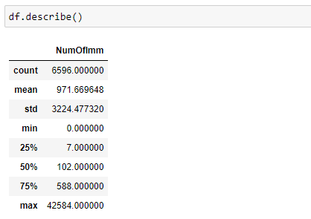
Statistics Descriptive

Slide 7
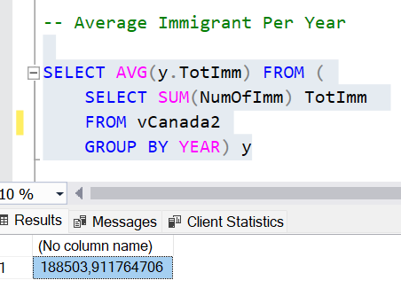
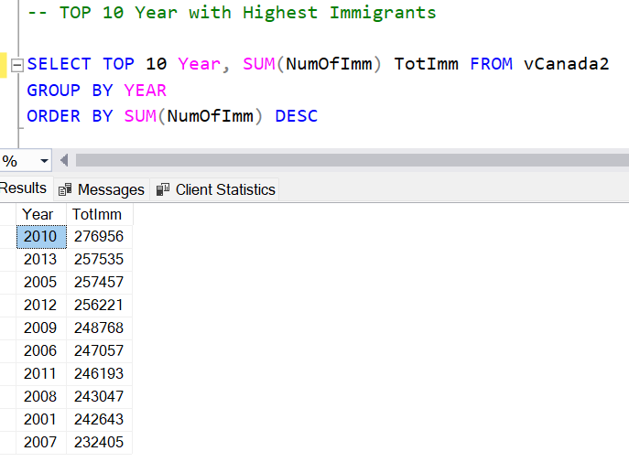
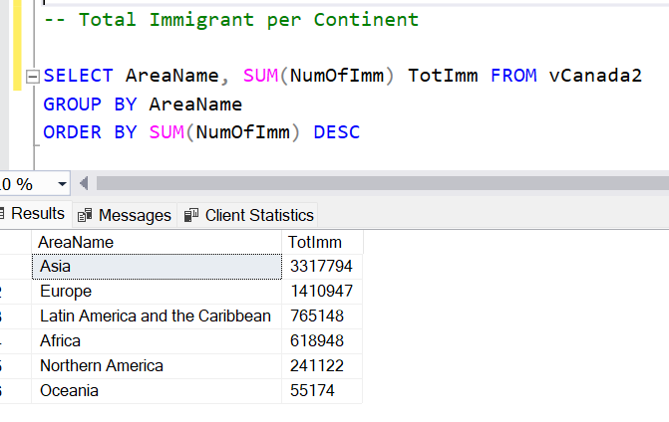
Univariate Analysis

Slide 8
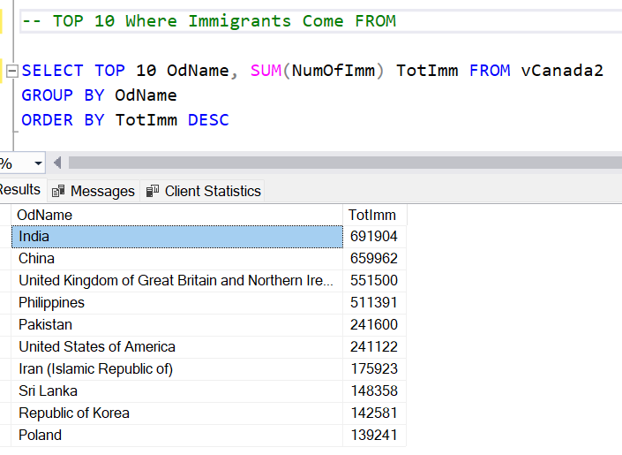
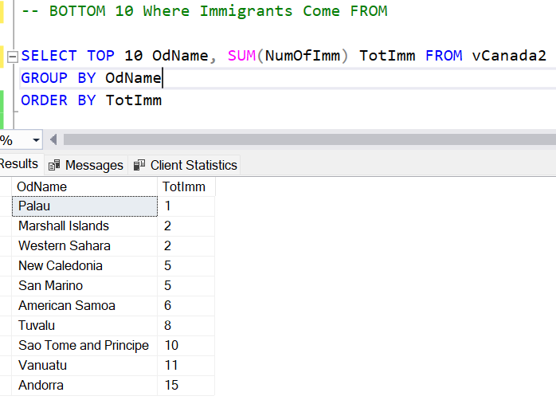
Univariate Analysis

Slide 9
Univariate Analysis

Slide 10
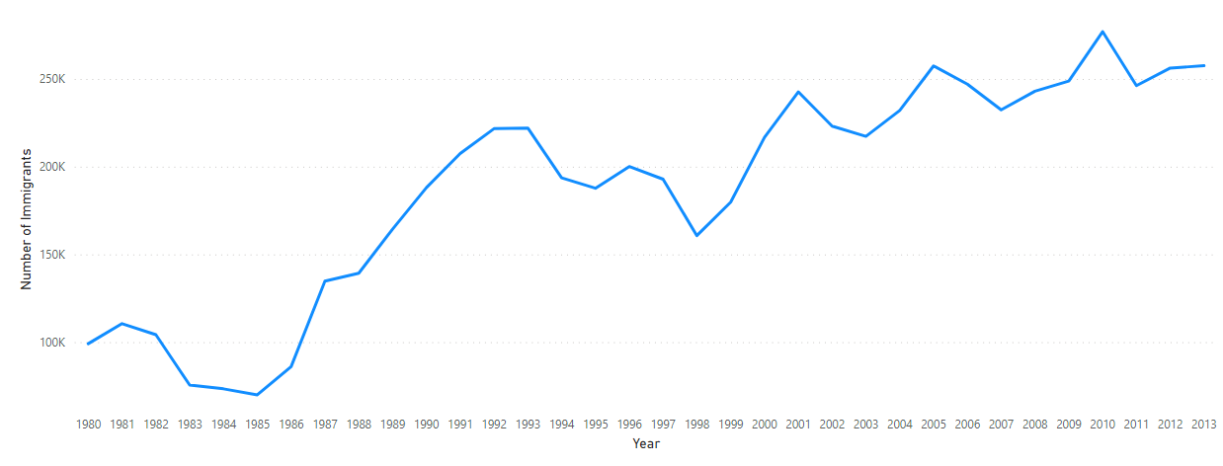
Visualization
Trend of Immigration in Canada tend to be ascending. Although there was a fluctuation with no significant fall which followed by high ascending trend

Slide 11
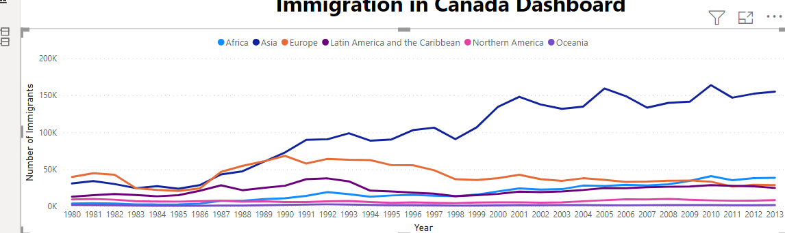
Visualization
Asia has been dominated in terms of number of their people who emigrated to Canada, followed by Europe, Africa, Latin America and the Caribbean, Northern America, and Oceania.

Slide 12
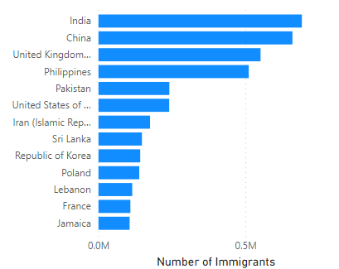
Visualization
At 691904 immigrants, India had the highest number of immigrants and was around 69% higher than Palau, which had the lowest number of immigrants at 1 immigrant.
India accounted for 10.8 % of number of immigrants in total.

Slide 13
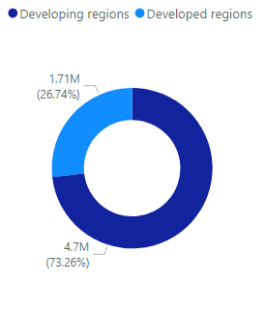
Visualization
Developing countries accounts 73.26% of total immigrants including several countries which is the most supplier of immigrants such as : India, China, Philippines, Pakistan, Iran, Sri Lanka, Republic of Korea, Lebanon, and Jamaica.

Slide 14
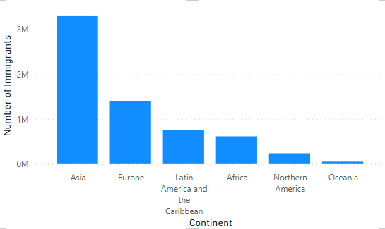
Visualization
At 3290087 immigrants, Asia had the highest number of immigrants and was 15.597% higher than Oceania, which had the lowest number of immigrants at 20959.
Asia had the highest number of immigrants followed by Latin America and the Caribbean, Africa, and Oceania.

Slide 15
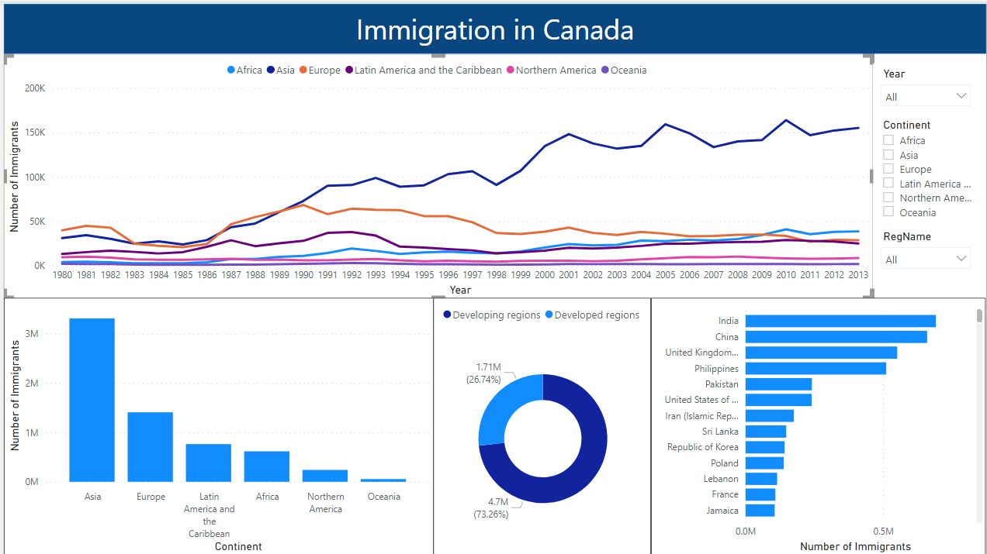
Dashboard

Slide 16
Recommendation
More detailed data are needed for further and comprehensive analysis such as: age range, gender, job type, etc

Slide 17

THANK YOU

